Slide 1
Infrastructure as a Service (IaaS) Amazon EC2
Notes:
The Challenge of the Computer Utility - Douglas F. Parkhill

Slide 2
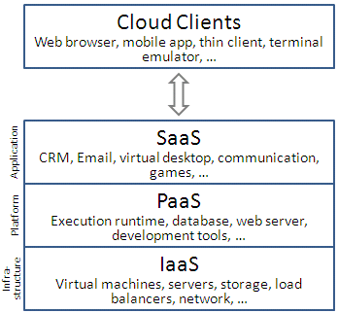
What is Infrastructure as a Service ?
A category of cloud services which provides capability to provision processing, storage, intra-cloud network connectivity services, and other fundamental computing resources of the cloud infrastructure. Source- [ITU –Cloud Focus Group]
Diagram Source: Wikipedia
Notes:
IaaS clouds often offer additional resources such as a virtual-machine disk image library, raw (block) and file-based storage, firewalls, load balancers, IP addresses, VLANs, and software bundles

Slide 3
Highlights of IaaS
On demand computing resources
Eliminate the need of far ahead planning
No up-front commitment
Start small and grow as required
No contract, Only credit card!
Pay for what you use
No maintenance
Measured service
Scalability
Reliability
Notes:
illusion of inﬁnite computing resources available on demand
EC2 instance looks much like physical hardware, and users can control nearly the entire software stack, from the kernel upwards

Slide 4
Amazon Elastic Compute Cloud ( EC2)
“Amazon Elastic Compute Cloud (Amazon EC2) is an Amazon Web Service (AWS) you can use to access servers, software, and storage resources across the Internet in a self-service manner “
Provides scalable, pay as-you-go compute capacity
Elastic - scales in both direction
Notes:
Basic idea is to rent infrastructure – virtual server and storage device - per hour
User virtual server to install / run any application

Slide 5
EC2 Concepts
AMI & Instance
Region & Zones
Storage
Networking and Security
Monitoring
Auto Scaling
Load Balancer

Slide 6
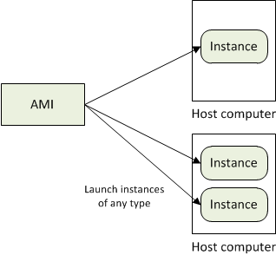
AMI and Instance
Amazon Machine Image (AMI) is a template for software configuration (Operating System, Application Server, and Applications)
Instance is a AMI running on virtual servers in the cloud
Each instance type offers different compute and memory facilities
Diagram Source: http://docs.aws.amazon.com
Notes:
Amazon publishes many AMI for public use
Custom AMIs provided by community members
User can create their own AMI
Instance type – different operating environment.
Amazon’s bet is that by statistically multiplexing multiple instances onto a single physical box, that box can be simultaneously rented to many customers who will not in general interfere with each others’ usage (see Section 7).

Slide 7
Region and Zones
Amazon have data centers in different region across the globe
An instance can be launched in different regions depending on the need.
Closer to specific customer
To meet legal or other requirements
Each region has set of zones
Zones are isolated from failure in other zones
Inexpensive, low latency connectivity between zones in same region
Notes:
for example, North America, Europe, and Asia).
Prices for Amazon EC2 usage vary by region
Each region contains multiple distinct locations called Availability Zones.

Slide 8
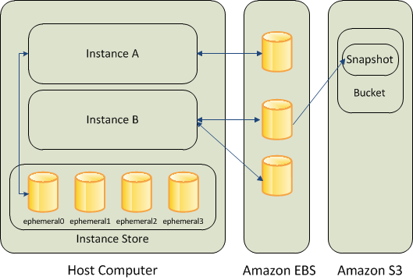
Storage
Amazon EC2 provides three type of storage option
Amazon EBS
Amazon S3
Instance Storage
Diagram Source: http://docs.aws.amazon.com
Notes:
Amazon EBS (Elastic Block Store) provides with persistent, block-level storage. Basically additional Hard Disk that you can attach to instance.
Suitable for apps which require database , filesystem , block level storage.
Create, Attach , Detach, Delete
- Standard volumes and Provisioned IOPS volumes.
Take snapshots that is stored in S3 , a new EBS can be re-created using the snapshot
Instance store comes with each instance except the micro-one , temporary block level storage.
Storage physically attached to the computer
S3 simple storage service
storage for the Internet
web service interface that enables you to store and retrieve any amount of data from anywhere on the web
Root device storage: contains image to boot the system
AMI categorized as “Backed by Amazon EBS” or “Backed by instance store”

Slide 9
Networking and Security
Instances can be launched on one of the two platforms
EC2-Classic
EC2-VPC
Instance IP address is dynamic.
new IP address is assigned every time instance is launched
Static IP address – Elastic IP address
Remap the Elastic IP to new instance to mask failure
Separate pool for EC2-Classic and VPC
Security Groups to access control to instance
Notes:
VPC - launch Amazon Web Services (AWS) resources into a virtual network that you've defined.
Configure VPC: select its IP address range, create subnets, and configure route tables, network gateways, and security settings.
Security Group - enables you to specify the protocols, ports, and source IP ranges that are allowed to reach your instances
Create multiple security groups , assign instance to a particular group , determine the traffic

Slide 10
Monitoring, Auto Scaling, and Load Balancing
Monitor statistics of instances and EBS
CloudWatch
Automatically scales amazon EC2 capacity up and down based on rules
Add and remove compute resource based on demand
Suitable for businesses experiencing variability in usage
Distribute incoming traffic across multiple instances
Elastic Load Balancing
Notes:
CloudWatch
Monitor, manage, and publish various metrics
Configure Alarms based on metrics

Slide 11
How to access EC2
AWS Console
http://console.aws.amazon.com
Command Line Tools
Programmatic Interface
EC2 APIs
AWS SDK

Slide 12
References
http://docs.aws.amazon.com
Above the Clouds: A Berkeley View of Cloud Computing - Michael Armbrust et.al 2009
International telecommunication union – Focus Group Cloud Technical Report
Wikipedia

